Slide 1
Marketing and Retail Analytics: Capstone Project
By-Anupam singh tomar

Slide 2
Agenda
Objective
Background
Key findings
Recommendations
Appendix:
Data sources
Data methodology

Slide 3
Objective
Improve our shared understanding of top products that contribute to the revenue (using 80/20 rule).
Improve our shared understanding with the use of market basket analysis to analyze the purchase behavior of customers.
Understand what items are more likely to be purchased individually or in combination with some other products.

Slide 4
Background
Olist has faced low revenues and they want to manage their inventory so as to reduce any unnecessary costs that might be incurring.
The company would need to store tons and tons of products in warehouses to be able to meet the demands of the customers .

Slide 5
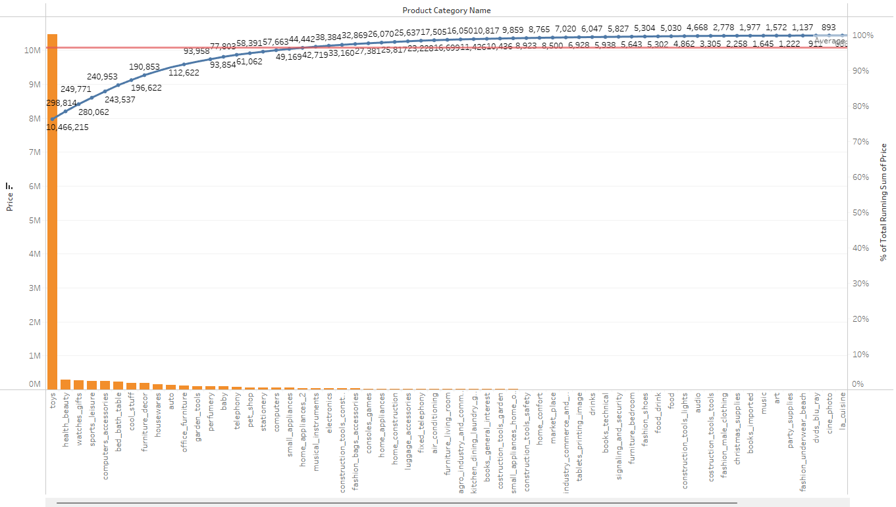
Key findings
Toys, health_beauty, and watches_gift combined generated more than 80% of the revenues.
The rest of the other products categories generated approx 20%.
Restocking Toys, health_beauty, and watches_gift would be good because they generate most profit

Slide 6
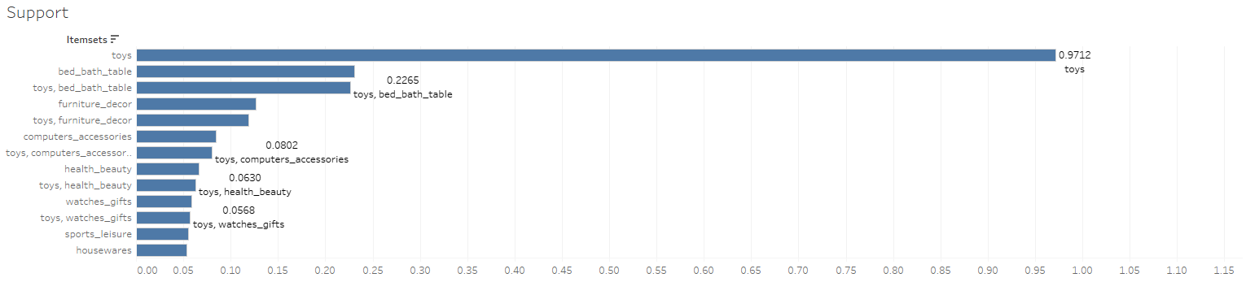
Key findings
Toys category is the most frequently purchased item individually having the highest support value of 0.97
We can give customers good deals on these product so that these product keep generating profit

Slide 7
Recommendations
Focus on the categories which generated more than 80% of the Revenue. keep them in stock.
Provide discounts on categories that are old stock, to move them quickly and keep the inventory new.
Shelf all top selling product together and also keep product that are usually sold together

Slide 8
Appendix
Here is a snapshot of our data dictionary:
Orders details such as order id, order status, price, shipping charges, etc.
Customer details such as customer id, customer city, and customer state.
Product attributes such as product id, product category name, and product dimensions.
The team used the following data sources:
OList retail dataset containing order-related information.
The data is for the years 2016 to 2018.

Slide 9
Appendix
Cleaning and transforming of data was done using the Python Libraries Pandas and Numpy in Jupyter Notebook.
Exploratory data analysis(EDA) was done using MatplotLib and Seaborn Python Libraries in Jupyter Notebook.
Market basket analysis was done using Mlxtend (machine learning extensions) Python Libraries in Jupyter Notebook.

